Slide 1
Implementation of Stack
Lecture #
By: Abdul Aleem

Slide 2
Contents
1 Introduction
2
Stack Implementation
3 Array Implementation of Stack
4 Linked List implementation of stack

Slide 3
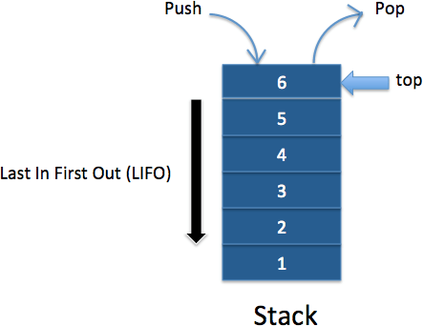
Introduction
Stack:
Stack is an ordered set of elements in which insertion and deletion are from one end of the stack called the Top of the stack.
It works on the principle Last In First Out (LIFO).
Figure 1: Stack LIFO

Slide 4
Stack Implementation
Static Implementation (Array Implementation)
Dynamic Implementation (Linked List Implementation)

Slide 5
Array Implementation of Stack
Array implementation of stack is a static implementation as the size of the stack is known.
class Stack
{
int top;
int MAXSIZE = 5;
int[] arr = new int[MAXSIZE];
}

Slide 6
isFull( )
public boolean isFull()
{
if(top == (MAXSIZE-1))
return true; else
return false;
}

Slide 7
PUSH Operations on Stack
public void push(int x)
{
if (isFull())
{
System.out.println("Overflow"); System.exit(0);
}
System.out.println("Inserting " + x); arr[++top] = x;
}

Slide 8
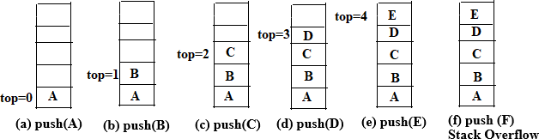
Push operations on stack
Figure 2: PUSH operation in Stack

Slide 9
isEmpty( )
public boolean isEmpty()
{
if(top == -1) return true; else
return false;
}

Slide 10
POP Operations on Stack
public int pop()
{
if (isEmpty())
{
System.out.println("Underflow"); System.exit(0);
}
return arr[top--];
}

Slide 11
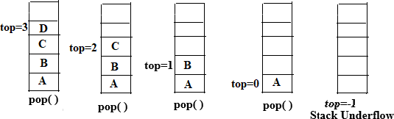
Pop operations on stack
Figure 3: POP operation in Stack

Slide 12
Display the stack
public int peek()
{
if (!isEmpty()) { return arr[top];
}
else {
System.exit(0);
}
return -1;
}

Slide 13
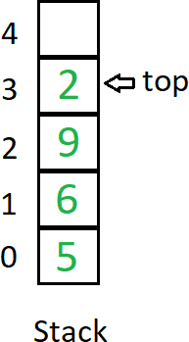
Display operation on stack (Example)
Figure 4: Display the Stack elements

Slide 14
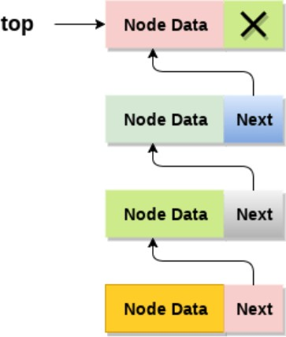
Linked List implementation of stack
Linked list allocates the memory dy- namically.
In linked list implementation of stack, the nodes are maintained non- contiguously in the memory.
Each node contains a pointer to its immediate successor node in the stack.
Figure 5: Linked List implementation of Stack

Slide 15
PUSH Operation
Adding a node to the stack is referred to as push operation. Pushing an element to a stack in linked list implementation is different from that of an array implementation. In order to push an element onto the stack, the following steps are involved.
Create a node first and allocate memory to it.
If the list is empty then the item is to be pushed as the start node of the list. This includes assigning value to the data part of the node and assign null to the address part of the node.
If there are some nodes in the list already, then we have to add the new element in the beginning of the list (to not violate the property of the stack). For this purpose, assign the address of the starting element to the address field of the new node and make the new node, the starting node of the list.

Slide 16
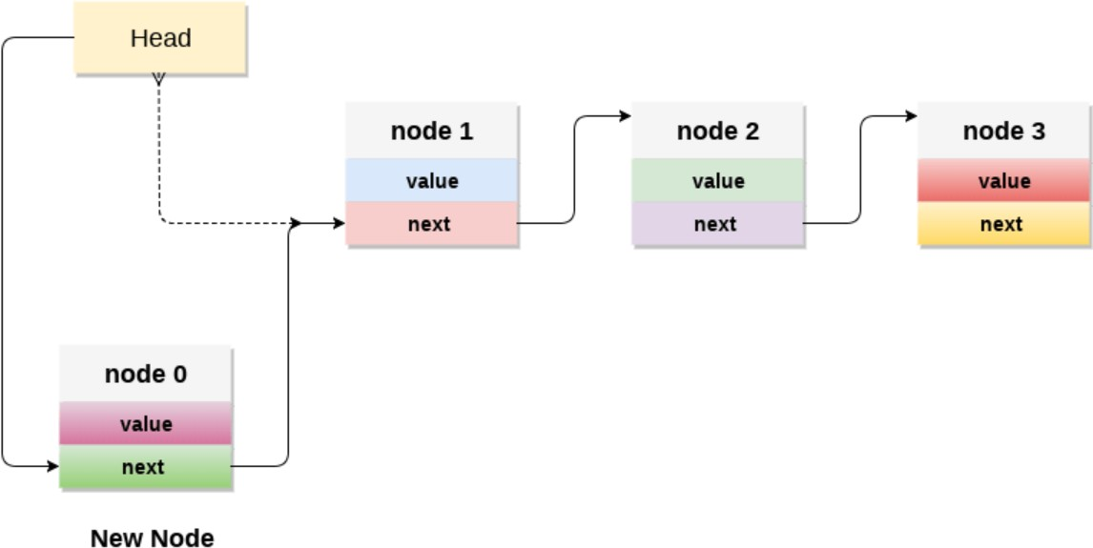
PUSH Operation
Figure 6: Adding a node to the Stack

Slide 17
POP Operation
Deleting a node from the top of stack is referred to as pop operation. In order to pop an element from the stack, we need to follow the following steps :
Check for the underflow condition: The underflow condition occurs when we try to pop from an already empty stack. The stack will be empty if the head pointer of the list points to null.
Adjust the head pointer accordingly: In stack, the elements are popped only from one end, therefore, the value stored in the head pointer must be deleted and the node must be free. The next node of the head node now becomes the head node.

Slide 18
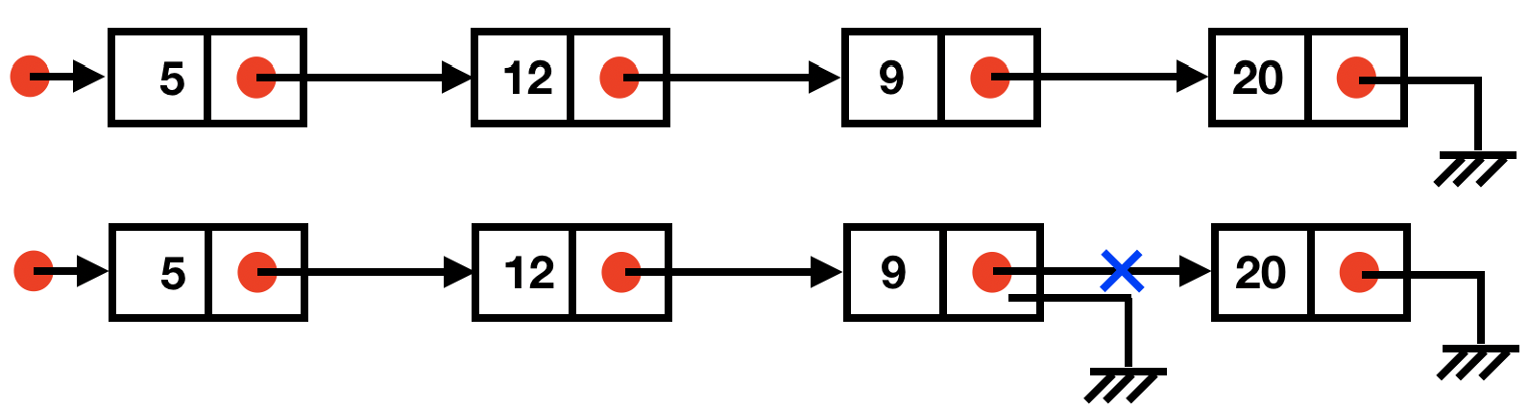
POP Operation
Figure 7: Deleting a node from the Stack

Slide 19
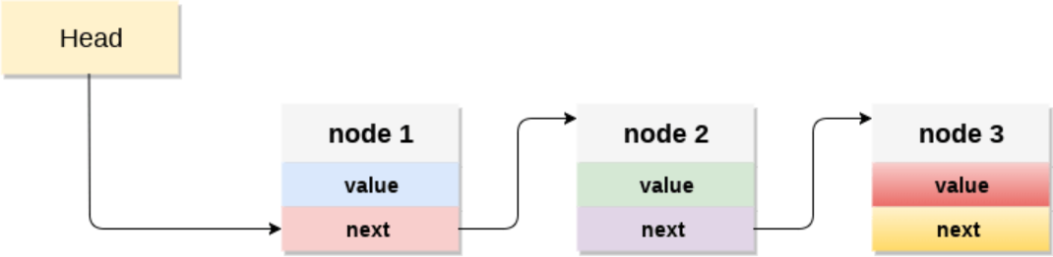
Display the nodes
Copy the head pointer into a temporary pointer.
Move the temporary pointer through all the nodes of the list and print the value field attached to every node.
Figure 8: Display the nodes in the Stack

Slide 20
[1] Goodrich and Tamassia ‘Data Structures and Algorithms in java ’, Wiley, India.
Reference

